Slide 1

WELCOME!
TO PASASDENA
CHRIS ATEEK
Principal of
Pasadena Fundamental Elementary
Notes:
BM and SLK

Slide 2
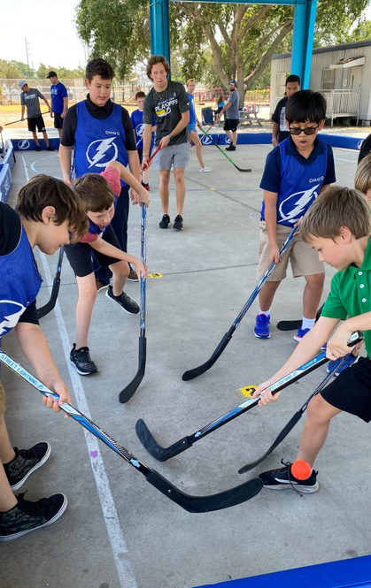
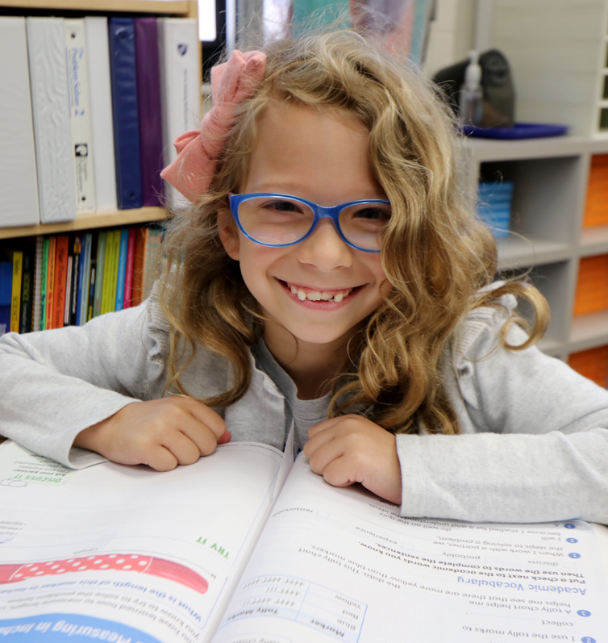

DISTRICT APPLICATION SCHOOL
Vision
100% Student Success
Mission
Our mission statement is to create a positive learning environment with high expectations where students, families, and faculty work in collaboration for 100% student success..

Slide 3

TIPS AS A FUNDAMENTAL PARENT
Check and Sign Student Agenda daily. Communicate with your child’s teacher.
Be sure you’re attending one school-approved function a month.
Check and Sign Student homework daily
Attend three conferences a year with the classroom teacher.
Provide transportation. Be on time. Students must be in class by 830A and pick up begins at 240P (until 310P)
Follow School Dress Code

Slide 4
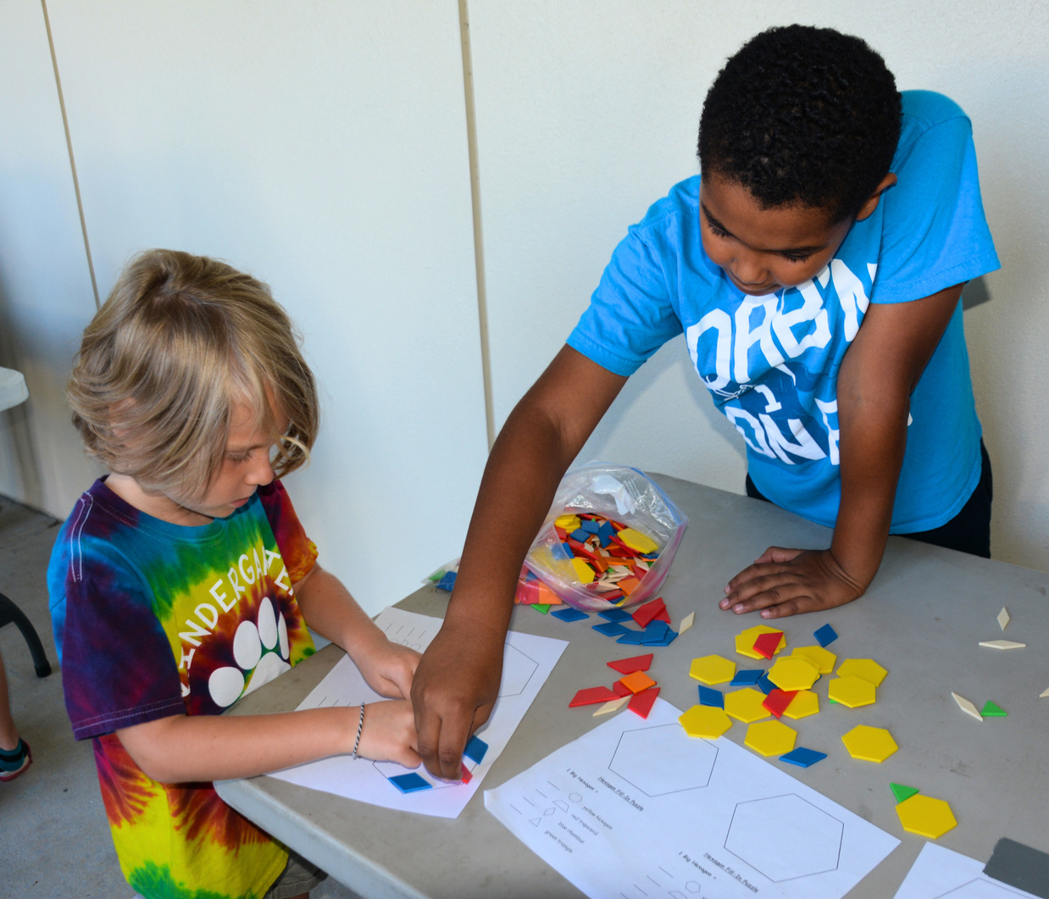

TIPS AS A FUNDAMENTAL STUDENT
Have your parents Check and Sign your Student Agenda daily.
Use your agenda as a checklist for items to be completed and signed by your parent.
Have your parent Check and Sign your homework daily. Most students find having a homework folder helpful, especially to help with getting parent signatures.
Follow school Dress code
Follow school behavior guidelines
Be sure your parents are attending one school-approved function a month.
Be on time to class. Students must be in class by 830A and pick up begins at 240P (until 310P)

Slide 5
DRESS CODE
Students are expected to dress appropriately to reflect pride in oneself and school, and to avoid social fads and disruptions to the school learning environment.
School-wide have a modified uniform policy
Students who come to school wearing inappropriate attire will be sent to the office to call home for acceptable clothing and will receive a dress code violation

Slide 6


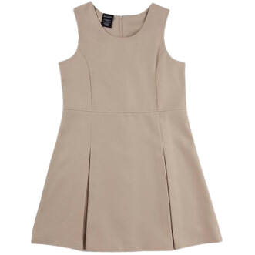
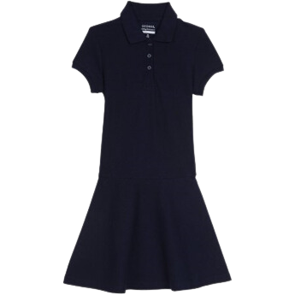


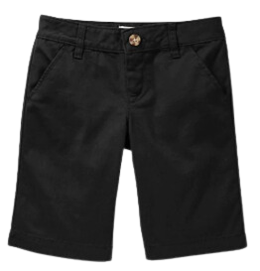
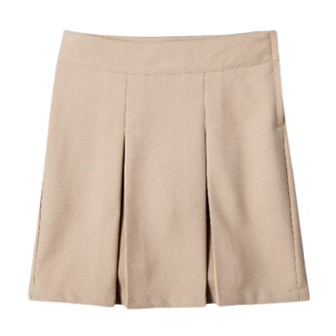
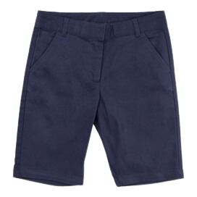
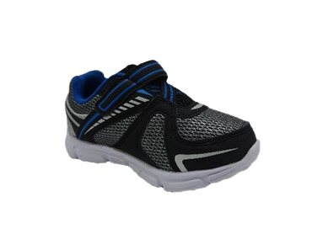
DRESS CODE

Slide 7
WHAT ARE INFRACTIONS?
Students can receive seven infractions per grading period
(3warnings/ 4detentions)
After three warnings, the student receives their first detention.
Any additional infraction is another detention
Upon receiving fourth detention, the student is referred to the intervention and appeals committee (IAC)
Detentions are held after school 30 minutes

Slide 8
HOW TO AVOID GETTING AN INFRACTION
Homework: completing assignments, completing the right assignment, signing agenda/homework, turned in on time
Classwork: completed, prepared for class
Behaviors: not being disruptive, not being harmful to others
Attending detentions
Returning all “sign and return” documents
Following the dress code
Avoiding excessive tardies (arrive to school on time)

Slide 9

Recognized as a top-performing school in Florida (Graded A school)
Recognized as a Gold Model Florida PBIS School
Defend a Friend Bullying Prevention program
School celebrations for character and academics
Music Concerts, Art Show, and World’s Fair
Class participation in the Great American Teach-In
Monthly school activities include Family Nights, Parent universities, PTA, and SAC meetings
Our school community logs in thousands of volunteer hours each year
Community service projects
Over 10,000 volunteer hours logged
POINTS OF PRIDE

Slide 10
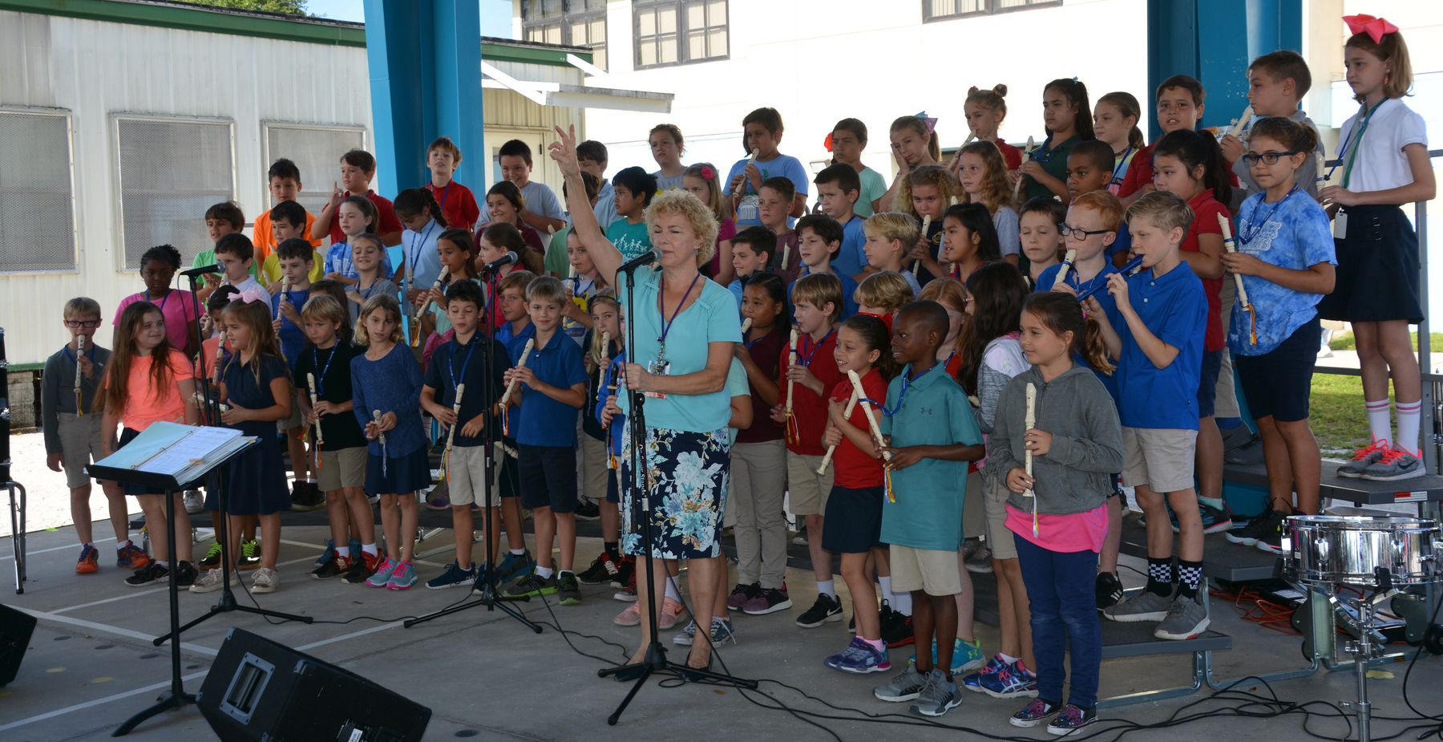
ENRICHMENT ACTIVITIES
There are ongoing extended learning opportunities before and after school. Clubs vary year to year and may include Student Council, STEM, Journalism Club, Chorus, Band, Art Club, Safety Patrols, Battle of the Books, News Crew, and Principal's Multicultural Advisory Committee (PMAC).

Slide 11
HOURS OF OPERATION
Student hours 830A to 240P
Office hours 730A to 345P
8A is the earliest drop-off time
Students are tardy if:
They are not in their seat at 830A
Have not been picked up by 310P or 10 minutes after the dismissal of an after-school activity

Slide 12
BEFORE/AFTER SCHOOL CARE
R’ Club is available for before and after school care:
630A – 820A
240P – 6P
Off-site options include Pasadena Community Church School, Gulfport Recreation, Bayside Sports Academy, Master Tony’s Taekwondo, American Mixed Marital Arts, After School Kicks
Please check each business for their availability and rates

Slide 13

BREAKFAST AND LUNCH
Breakfast is free for all students from 800A - 820A
School lunch fee for the 2025-2026 school year is
If you would like your child to purchase an additional item, please send money or prepayments can be made
If your child brings a lunch, please make sure you pack everything your child needs for their lunch and teach them to open their lunch box and any items they may have in it

Slide 14

DATES TO REMEMBER
District Application Program Enrollment Period
9 a.m. on January 6 through 5 PM on January 16, 2025
District Application Program (DAP) Acceptance Period
9 a.m. February 10 through 5 PM on February 20, 2026
Sibling Priority Week (if invited)
February 23- February 27, 2026
Late Application Period
March 24, 2025

